Slide 1
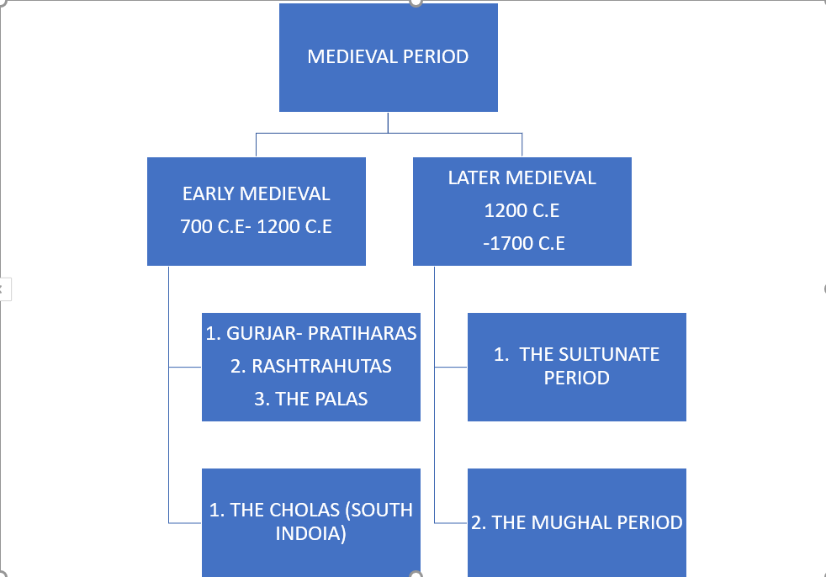

Slide 2
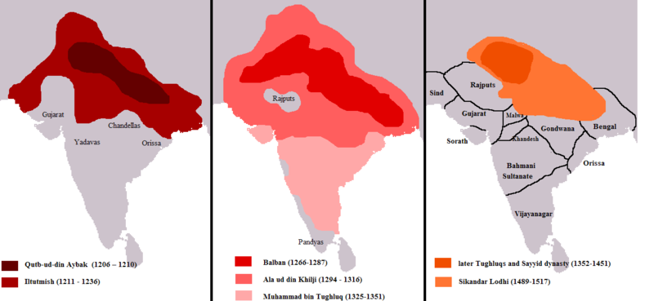
THE DELHI SULTANS - BEGINNING OF THE LATER MEDIEVAL PERIOD
This Photo by Unknown Author is licensed under CC BY-SA

Slide 3
HISTORY OF DELHI – HOW DELHI CAME INTO PROMINENCE
1.Delhi first became the capital of a kingdom under the Tomara Rajputs, who were defeated in the middle of the twelfth century by theChauhans(also referred to as Chahamanas) of Ajmer.
2. It was under the Tomaras and Chauhans that Delhi became an important commercial centre.
3.Coins minted here, called dehliwal, had a wide circulation.
4. The transformation of Delhi into a capital that controlled vast areas
of the subcontinent started with the foundation of the DelhiSultanate in the beginning of the thirteenth century.

Slide 4
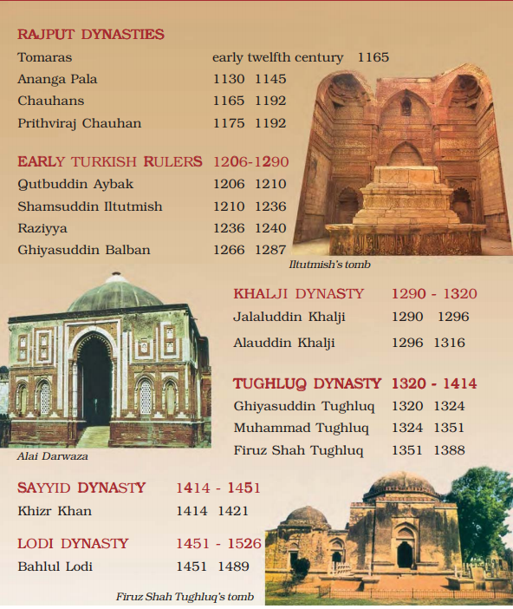
THE RULERS OF DELHI

Slide 5
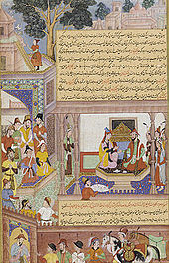
TWARIKH
Although inscriptions, coins and architecture provide
a lot of information, especially valuable are “histories” tarikh (singular) / tawarikh (plural), written in Persian,
The authors of tawarikh lived in cities (mainly Delhi) and hardly ever in villages.
(2) They often wrote their histories
for Sultans in the hope of rich rewards.
(3) These authors advised rulers on the need to preserve an “ideal” social
order based on birthright and gender distinctions.
(4) The authors of tawarikh were learned men: secretaries, administrators, poets and courtiers, who both recounted events and advised rulers on governance, emphasising the importance of just rule.
This Photo by Unknown Author is licened under CC BY-SA

Slide 6
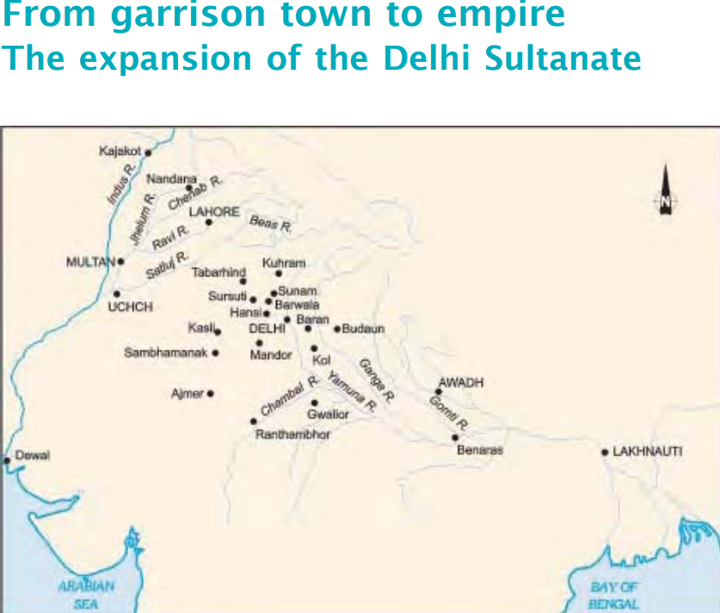
In the early part of the Sultunate period, the Sultans controlled only small and heavily fortified GARRISON TOWNS.
Garrison towns were fortified settlement, with soldiers.
The first set of campaigns along the “internal frontier”of the Sultanate aimed at consolidating the hinterlands of the garrison towns.
Hinterlandns are The lands adjacent to a city or port that supply it with goods and services.
During these campaigns forestswere cleared in the Ganga-Yamuna doab and hunter gatherers and pastoralists expelled from their habitat.
These lands were given to peasants and agriculture was encouraged

Slide 7
THE SECOND PHASE OF EXPANSION OF THE SULTUNATE
1.The second expansion occurred along the “external
frontier” of the Sultanate.
2.Military expeditions into southern India started during the reign of Alauddin Khalji (see Map 3) and culminated with Muhammad
Tughluq.
3. In their campaigns, Sultanate armies captured elephants, horses and slaves and carried away precious metals.
4.By the end of Muhammad Tughluq’s reign, the armies of the
Delhi Sultanate had marched across a large part of the
subcontinent.

